Slide 1
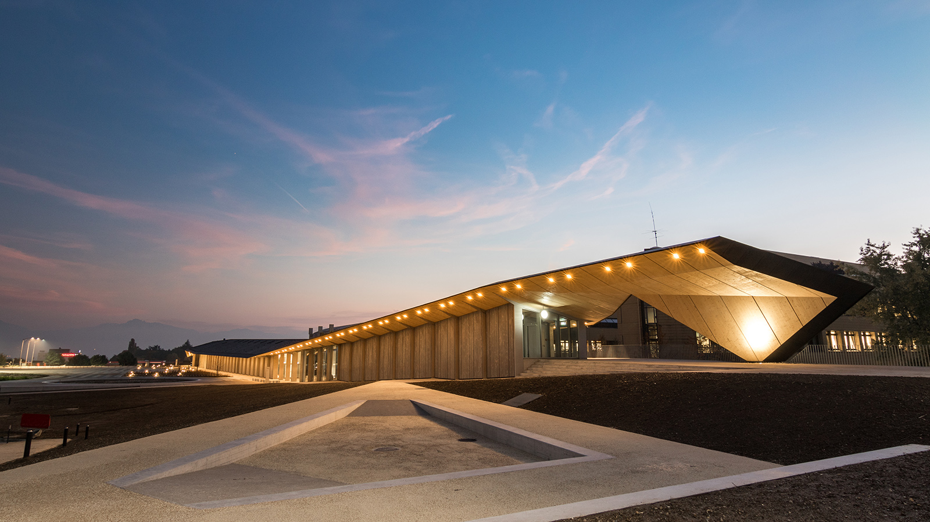

SoftWEAR - Wearable Robotics Platform
Semester Project

Slide 2
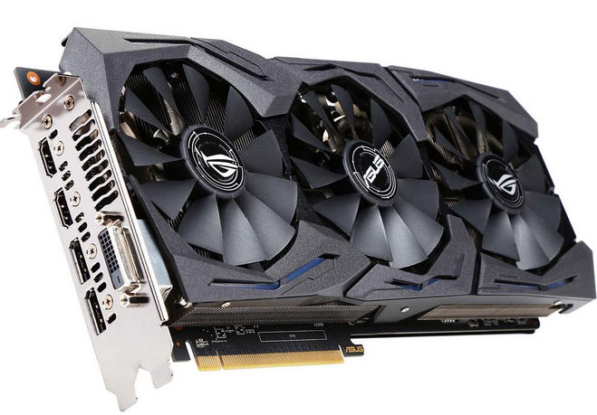
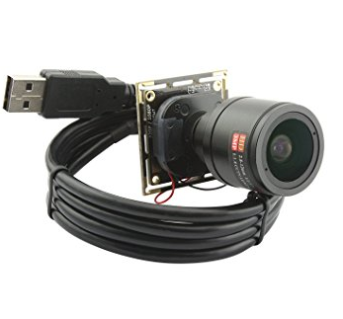
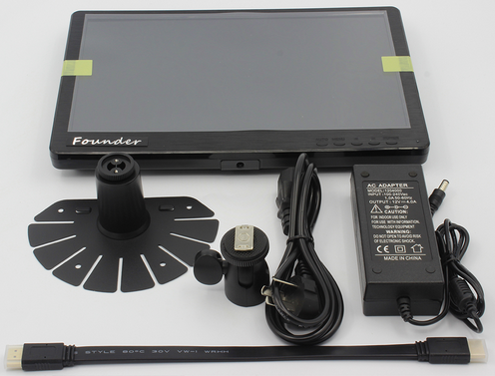
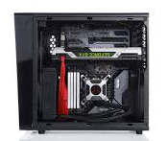
Motivation
Scenario: you are a real time graphics processing researcher.

Slide 3
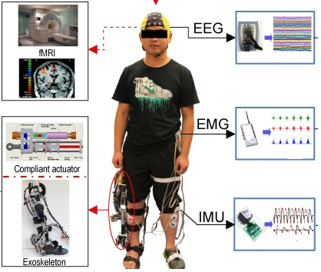
Motivation
Reality: you are doing research with wearable robotics
No plug-and-play platform
Serious effort in developing the set-up
Lack of device standards

Slide 4
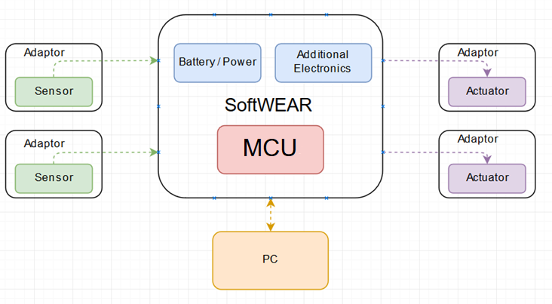
Platform Architecture

Slide 5
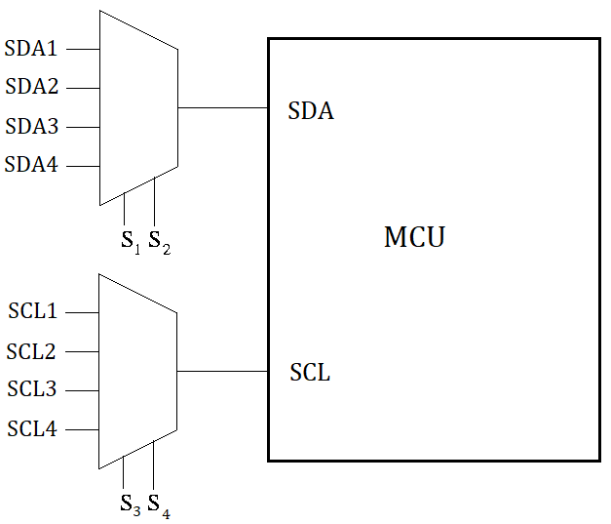
I/O list and Input Multiplexing
5x Analog Inputs
5x I2C Inputs
5x UART Inputs
5x SPI Inputs
5x PWM Outputs

Slide 6
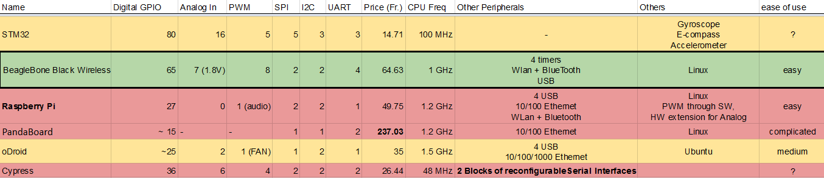
Documentation Phase
Choosing the platform core & documenting on the peripheral sensors / actuators.

Slide 7
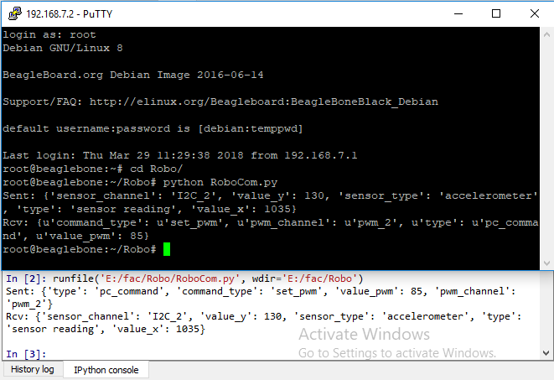
PC Communication
Importable python class that uses TCP sockets
Uses separate threading in the background
Can send most python objects, including lists and dictionaries

Slide 8
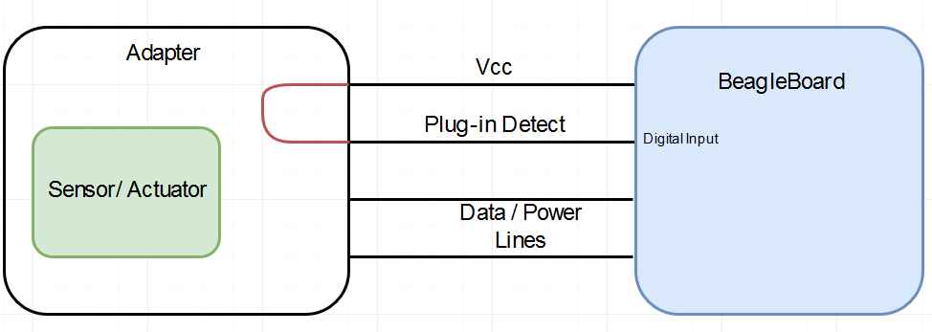
Hardware Recognition
1st Option: Single Digital Input Pin

Slide 9
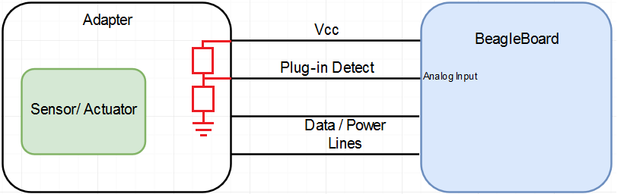
Hardware Recognition
2nd Option: Single Analog Input Pin

Slide 10
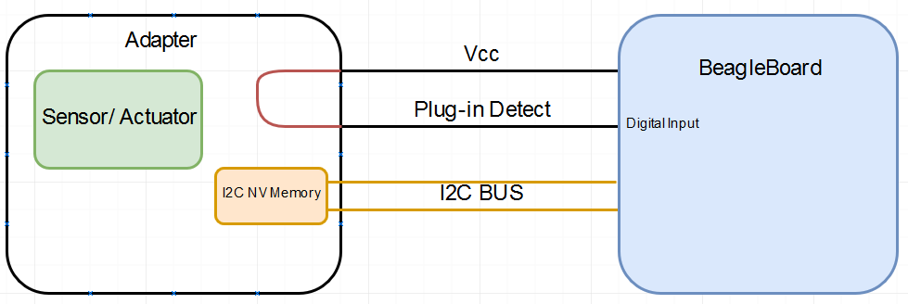
Hardware Recognition
3rd Option: I2C Memory

Slide 11
Hardware Recognition
4th Option: Software
Detection done 100% in the BeagleBone software
Different approaches for each interface type:
Analog in: Detect values above 0V
UART, SPI, I2C: Send known polling commands continuously; listen for answer
PWM: Listen to feedback pin (if any), maybe use 1st Solution

Slide 12
Hardware Recognition
 | Advantages | Disadvantages
1st Solution | No extra components, only 1 extra line Ease of implementation | Unable to properly identify different sensors / actuators on the same interface
2nd Solution | Only a few cheap components needed Multiple sensors / actuators can be identified on the same interface Relatively easy to implement | Extra Analog MUX required Number of supported devices is limited New devices require changes in the BB Software
3rd Solution | Different sensors / actuators can be precisely identified on the same interface Drivers can be stored in the NV memory New devices can be added without firmware updates to the BB Software | Largest development effort High complexity even for simple sensors / actuators
4th Solution | No extra components or extra lines The adaptor size and complexity is minimized | Possibly slow and complicated detection New devices require changes in the BB Software Some user interaction might be required

Slide 13
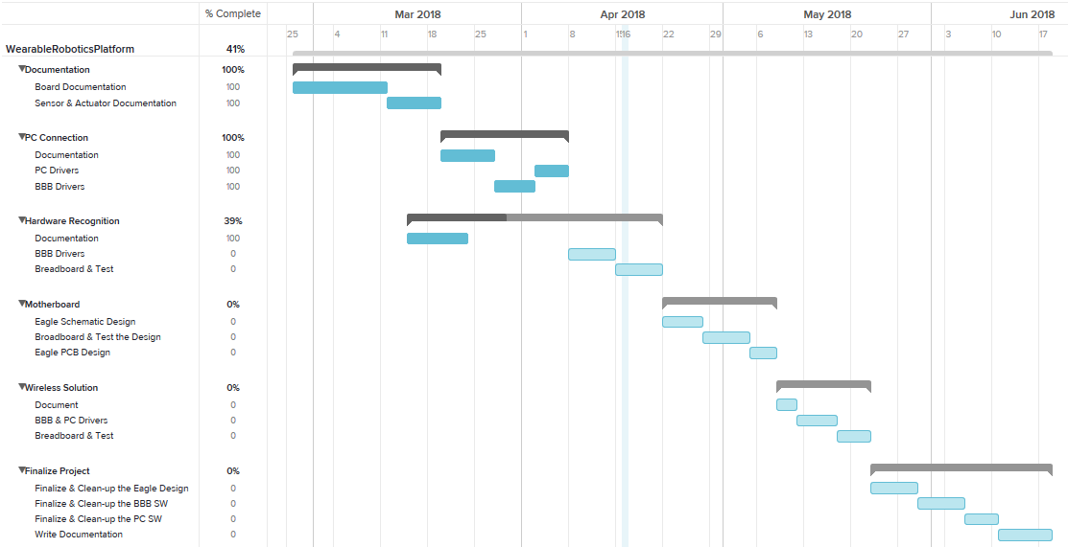
Timeline

Slide 14

Questions?

